Slide 1
Android Auto Message App

Slide 2







Gather Information
Download Android Studio
Android Auto Documentation
YouTube
Blogs
Skillshare
GitHub Examples

Slide 3
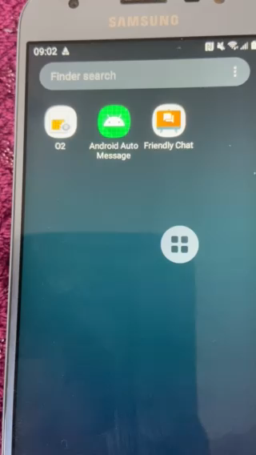
First Iteration
Create Simple Text-to-Speech Android App
Followed Basic Android App Tutorial
Skillshare
Text-To-Speech Example
YouTube
Add Android Auto Support
Android Auto Documentation
Test on Android Auto Desktop Head Unit
Failure

Slide 4
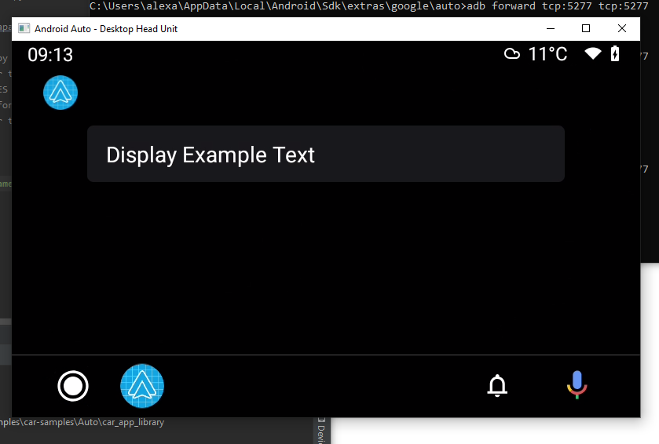
Second Iteration
Follow Android Auto Samples
Create Simple App to Display Text
Test on Android Auto Desktop Head Unit
Success!

Slide 5
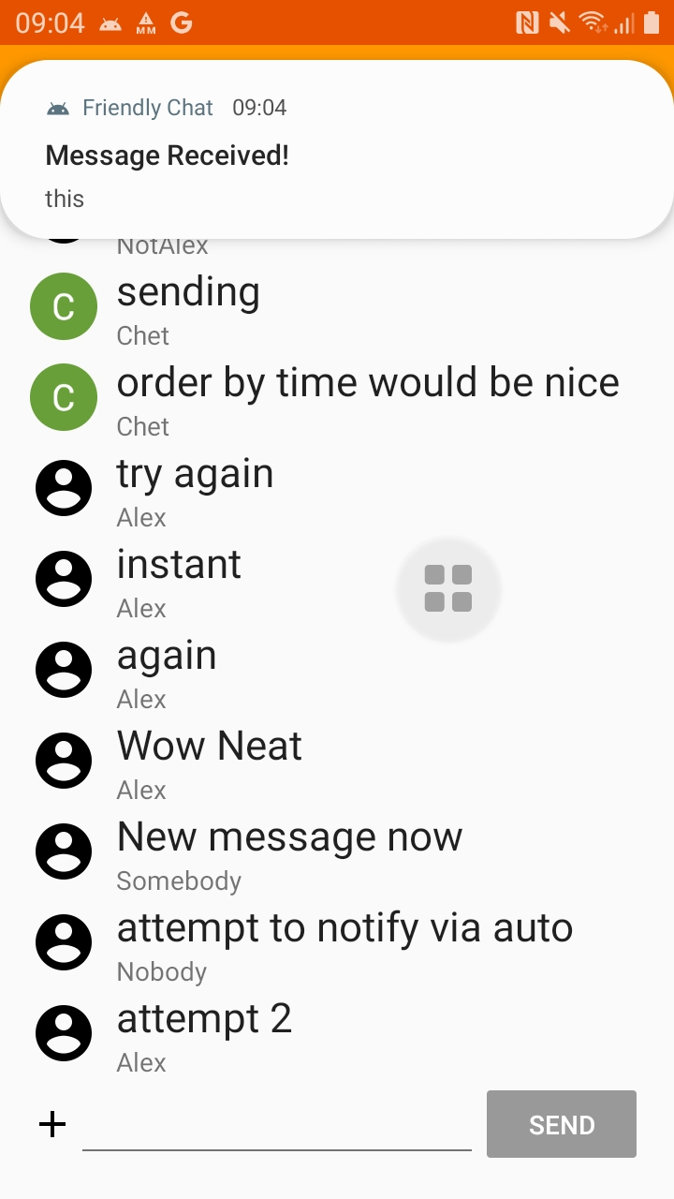
Third Iteration
Follow Android Auto Messaging Documentation
Assumes Starting with a base app Chat App
Followed Codelab Firebase Friendly Chat App Tutorial
Added Notifications

Slide 6
Next Steps
Put It All Together
Implement Messaging Service provided by adding new Android Auto Module
Create Reply Action
Create Mark As Read Action
Create MesssagingStyle
Add reply, mark as read, messaging style to build notification
Test

